Slide 1

Keystone School Of Engineering
Department : E&TC
Title : Heartbeat sensor using Arduino
Group no. : 10
Geeta Gujar - 06
Aishwarya Sutar – 18
Bhagyashree Kamble – 26 Guide & Coordinator name:
Prof. Sheetal Waghchaware

Slide 2
Index
Introduction
Literature Survey
Principle of Heartbeat sensor
Components with specification
Block Diagram
Circuit diagram
Working of heartbeat sensor
Advantages
Application
Future Scope
References

Slide 3
Introduction
More than 2 million people are at high risk of having heart attack.
It would be helpful if there was a way for these people to monitor their heart .So we have a problem. That is the way our project focuses on how we can overcome this problem and find a solution.
Monitoring heart rate is very important for athletes, patients as it determines the condition of the heart (just heart rate). There are many ways to measure heart rate and the most precise one is using an Electrocardiography
But the more easy way to monitor the heart rate is to use a Heartbeat Sensor. It comes in different shapes and sizes and allows an instant way to measure the heartbeat.
Heartbeat Sensors are available in Wrist Watches (Smart Watches), Smart Phones, chest straps, etc. The heartbeat is measured in beats per minute or bpm, which indicates the number of times the heart is contracting or expanding in a minute.

Slide 4
Literature survey
Sr. No. | Papers | Year Of Publication | Author | Method
1. | Heart Pulse Monitoring and Notification System using Arduino | 2021 | Hari Kiran Pendurthi, Siva Sai Kanneganti, Jaswanth Godavarthi. | Embedded system, IOT
2. | Arduino & IoT Based Health Surveillance Systems | 2021 | Hanan Abed Alwally, Ruqayah A. Ulwali, Noor Abd allah Othman, Marwa Ibrahim Shamel | IOT
3. | Health Monitoring and Predicting System using Internet of Things & Machine Learning | 2021 | Riyazulla Rahman .J Shridhar Sanshi , N. Nasurudeen Ahamed, | IOT, Machine Learning
4. | Secure and smart system for monitoring patients with critical cases | 2020 | Hanan Abed Alwally Abed Allah, Rawsam Abduladheem Hasan | IOT
5. | A Survey on Tracing Heart Attacks by Pulse Monitoring in IoT | 2019 | C. Santhanakrishnan, N. Gayathri Poojitha, Jahnavi Reddy L | IOT

Slide 5
Principle of Heartbeat Sensor
The principle behind the working of the Heartbeat Sensor is Photoplethysmograph. According to this principle, the changes in the volume of blood in an organ is measured by the changes in the intensity of the light passing through that organ.
Usually, the source of light in a heartbeat sensor would be an IR LED and the detector would be any Photo Detector like a Photo Diode, an LDR (Light Dependent Resistor) or a Photo Transistor.
With these two i.e. a light source and a detector, we can arrange them in two ways: A Transmissive Sensor and a Reflective Sensor.

Slide 6
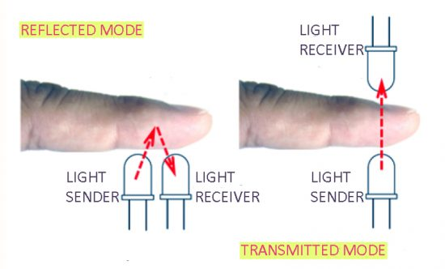
In a Transmissive Sensor, the light source and the detector are place facing each other and the finger of the person must be placed in between the transmitter and receiver.
Reflective Sensor, on the other hand, has the light source and the detector adjacent to each other and the finger of the person must be placed in front of the sensor.

Slide 7
Components
 | Components List
1. | Arduino UNO x 1
2 | 16 x 2 LCD Display
3 | 10KΩ Potentiometer
4 | 330Ω Resistor
5 | Push Button
6 | Heartbeat Sensor Module with Probe
7 | Mini Breadboard
8 | Connecting Wires

Slide 8
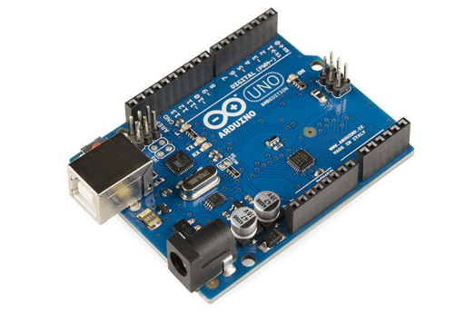
1. Arduino
Microcontroller: ATmega328P
Operating Voltage: 5V
Input Voltage (recommended): 7-12V
Digital I/O Pins: 14 (of which 6 provide PWM output)
Analog Input Pins: 6
DC Current per I/O Pin: 20 mA
Flash Memory: 32 KB (ATmega328P
Clock Speed: 16 MHz
LED_BUILTIN: 13
Length: 68.6 mm
Width: 58.4 mm
Weight: 25 g

Slide 9
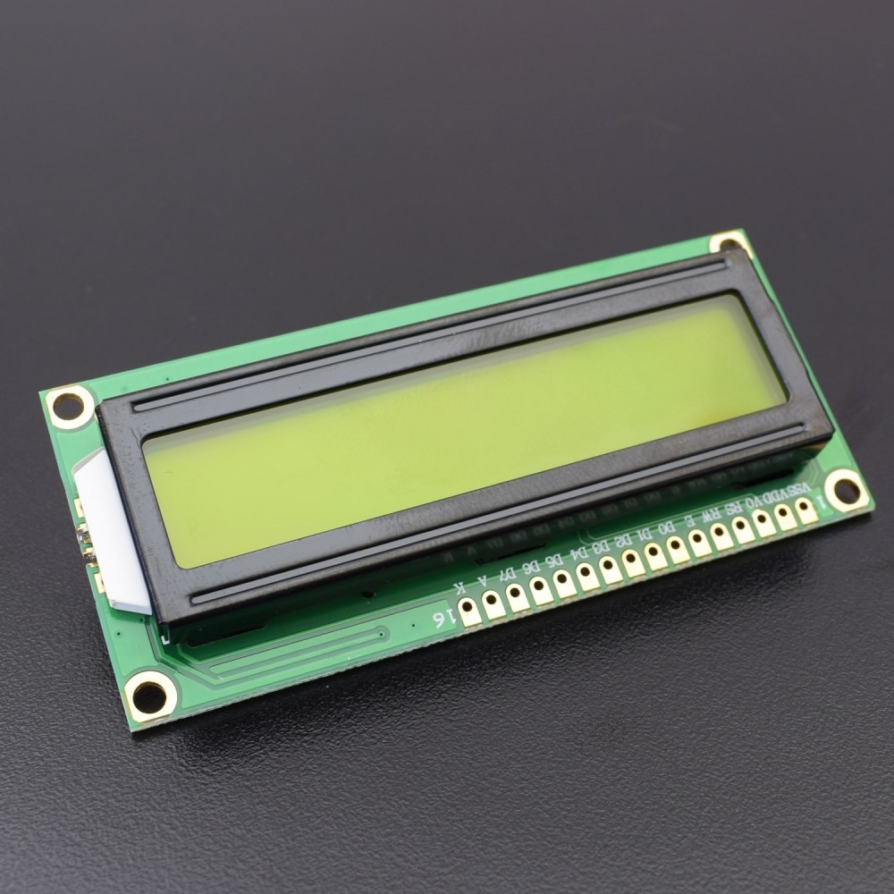
2.LCD Display
The display bezel is 72 x 25mm
The operating current is 1mA
LED color for backlight is green or blue
Number of columns – 16
Number of rows – 2
Number of LCD pins – 16
Characters – 32
It works in 4-bit and 8-bit modes
Pixel box of each character is 5×8 pixel
Font size of character is 0.125Width x 0.200height

Slide 10
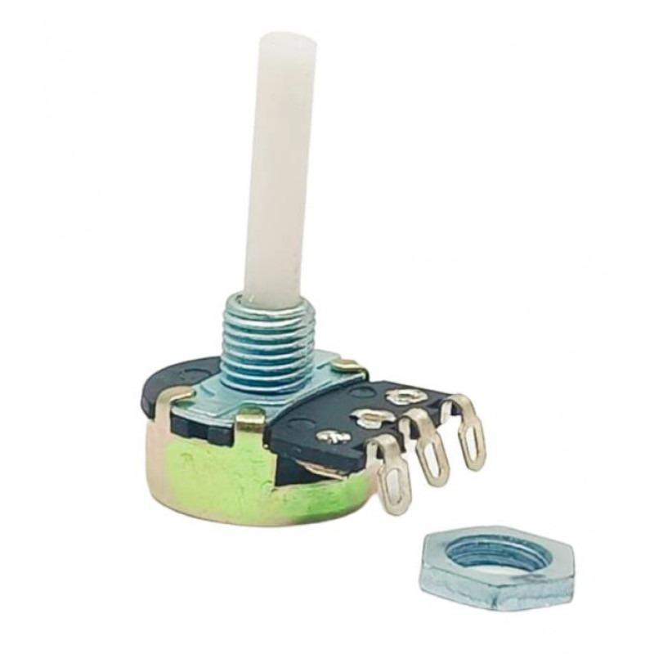
3.Potentiometer
Material Used : Plastic
Linear type with a single turn
Compact size
Value:- 0- 10K
Resistance Tolerance:- ±10%
Rotation angel:- 210 ±20 °
Rotational Life Cycle:- 200 cycles
Temperature range : - -55 to +125 °C

Slide 11
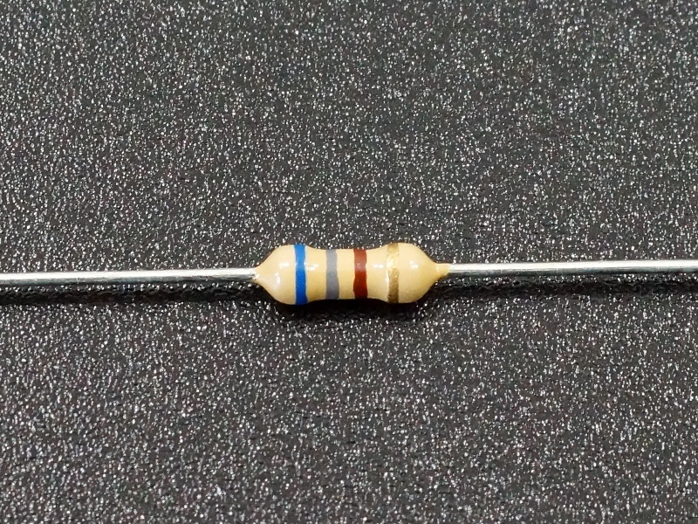
4. Resistor
Resistance: 330 Ohms.
Power (Watts): 0.25W, 1/4W.
Temperature Coefficient: 350ppm/Celsius.
Tolerance: +/- 5%
Case: Axial.
Size: 0.094" Dia x 0.248" L (2.40mm x 6.30mm)

Slide 12
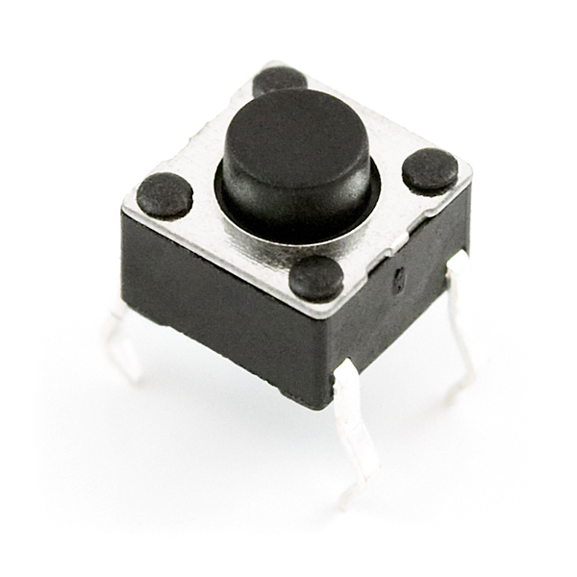
5. Push Button
Mode of Operation: Tactile feedback
Power Rating: MAX 50mA 24V DC
Insulation Resistance: 100Mohm at 100v
Operating Force: 2.55±0.69 N
Contact Resistance: MAX 100mOhm
Operating Temperature Range: -20 to +70 ℃
Storage Temperature Range: -20 to +70 C

Slide 13
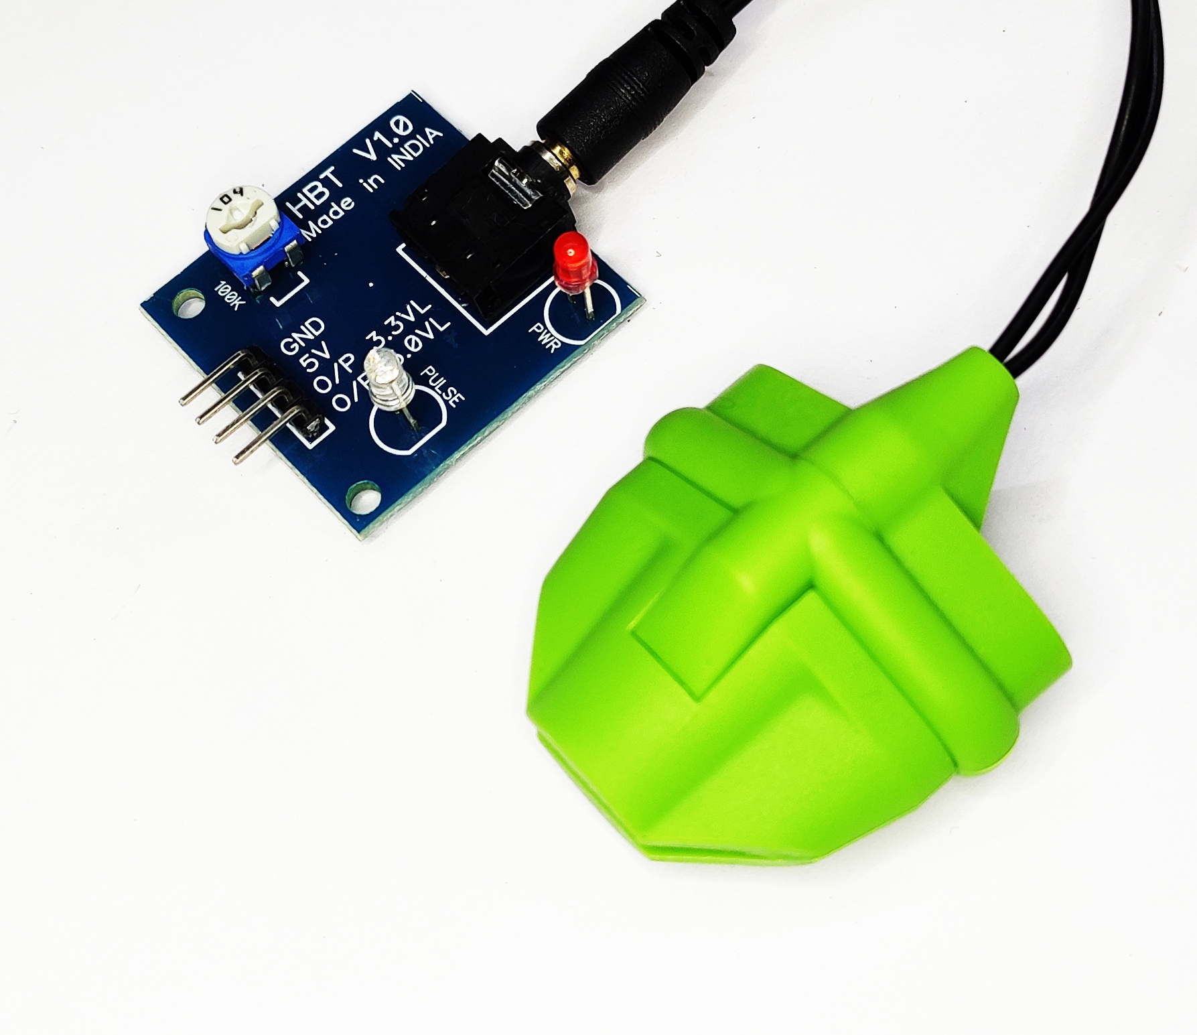
6. Heartbeat Sensor
Operating Voltage : +5V DC regulated
Operating Current : 100 mA
Output Data Level : 5V TTL level
Heart Beat detection : Indicated by LED and Output High Pulse
Light source : 660nm Super Red LED

Slide 14
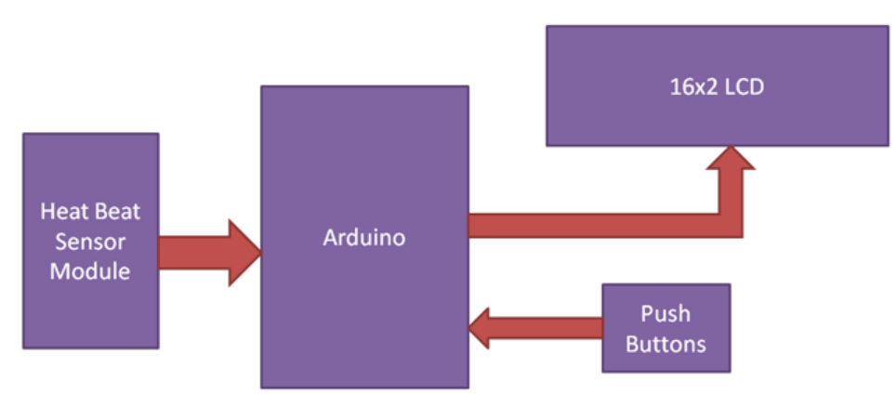
Block diagram

Slide 15
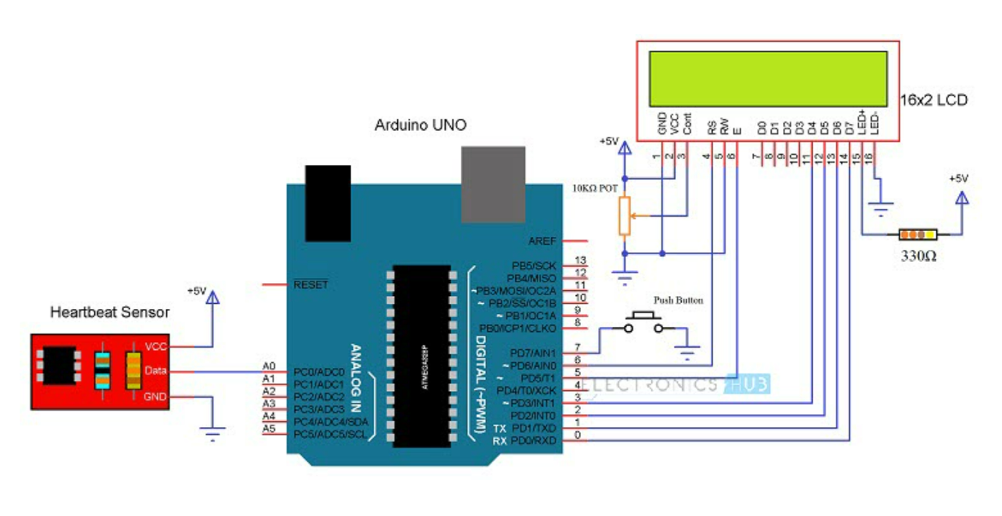
Circuit diagram

Slide 16
Working of Heartbeat Sensor
A simple Heartbeat Sensor consists of a sensor and a control circuit. The sensor part of the Heartbeat Sensor consists of an IR LED and a Photo Diode placed in a clip.
The Control Circuit consists of an Op-Amp IC and few other components that help in connecting the signal to a Microcontroller. The working of the Heartbeat Sensor can be understood better if we take a look at its circuit diagram.
The above circuit shows the finger type heartbeat sensor, which works by detecting the pulses. Every heartbeat will alter the amount of blood in the finger and the light from the IR LED passing through the finger and thus detected by the Photo Diode will also vary.
The output of the photo diode is given to the non – inverting input of the first op – amp through a capacitor, which blocks the DC Components of the signal. The first op – amp acts as a non – inverting amplifier with an amplification factor of 1001.

Slide 17
The output of the first op – amp is given as one of the inputs to the second op – amp, which acts as a comparator. The output of the second op – amp triggers a transistor, from which, the signal is given to a Microcontroller like Arduino.
The Op – amp used in this circuit is LM358. It has two op – amps on the same clip. Also, the transistor used is a BC547. An LED, which is connected to transistor, will blink when the pulse is detected.

Slide 18
Advantages
A heart beat sensor gives you clear indication and evaluation of the condition of your cardiovascular system during physical activity.
Using heart beat sensor can be your personal coach.
Easy to read has a clear screen and good scale.
Quick response for any Heartbeat rate changes.
Precision accuracy in heartbeat measurement.
You can quickly check your heart rate or start a training session without having to put on a separate chest strap.

Slide 19
applications
Have become a widely used training aid for a variety of sports.
Hospitals / Dispensaries
Better and accurate method of measuring heart beat.
At homes
A set point can help in determining whether a person is healthy or not checking
his/her heart beat and comparing with set point.

Slide 20
Future scope
Monitoring device that could be used to detect the heart beat anomalies of physically challenged Individuals without hands.
Also a graphical LCD can be used to display a graph of the change of heart rate over time.

Slide 21
References
S.M. Sabbir Ahamed, Md. Ashiqur Rahman Emu, Wardah Saleh, Heartbeat Sensor System for Remote Health Monitoring based on IOT (2021), American International University, Bangladesh.
R.KARTHIK, SHAIK ASLAM , SYED ABDUL HAFEEZ, T.KEERTHI, Heartbeat Sensor using Arduino(2021), KONERU LAKSHMAIAH EDUCATION FOUNDATION VADDESWARAM.
Reshma Sai Priya Talluri, Jai Surya Y, Sri Lakshmi Manchala, Heart Rate Monitoring System using Heart Rate Sensor and Arduino Uno with Web Application (2021), Blue Eyes Intelligence Engineering & Science.
R.Vinodhini, R.Puviarasi, Heart Rate Monitoring System using Pulse Sensor with Data Stored on Server(2020), International Journal of Engineering and Advanced Technology (IJEAT)
Mahima Chawla, Heartbeat And Body Temperature Monitoring Using Arduino(2020).

Slide 22
Thank you!

